Slide 1
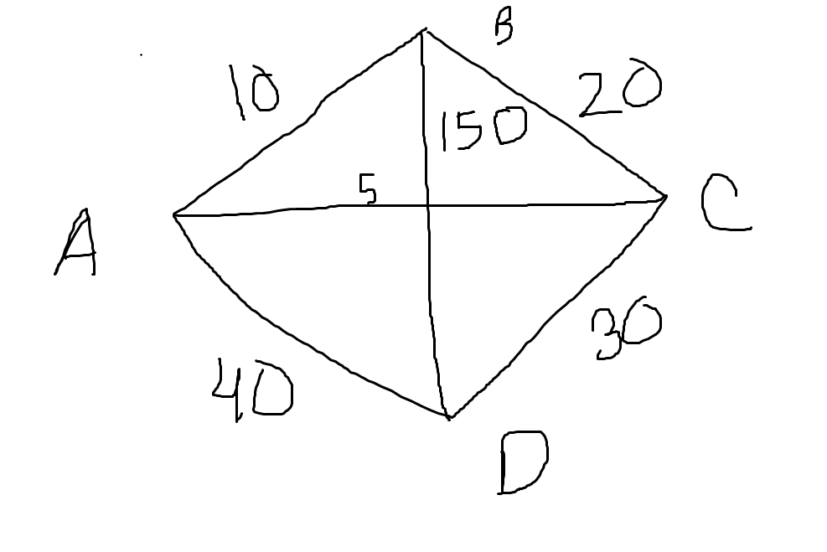
[ 0 10 5 40
10 0 20 150
5 20 0 30
40 150 30 0]

